Slide 1

LAW is:
The term “Law’ denotes different kinds of rules and Principles. Law is an instrument which regulates human conduct/behavior. Law means Justice, Morality, Reason, Order, and Righteous from the view point of the society. In old English “Lagu” i.e. law, ordinance, rule, regulation from old norse “lagu” law collective Plural of “Lag” is layer, measure, stroke ‘Literally’ something laid down of fixed.
In general terms law means the system of rules which a particular country or community recognizes as regulating the actions of its members and which it may enforce by the imposition of penalties.
Definition of law is a rule of conduct developed by the government or society over a certain territory. Law follows certain practices and customs in order to deal with crime, business, social relationships, property, finance, etc. The Law is controlled and enforced by the controlling authority.

Slide 2

COURT is:
The definition of 'court' in section 3 provides that it includes all Judges and Magistrates and all persons except arbitrators legally authorised to take evidence.
(a) Section 2 of the Code of Civil Procedure, 1908; section 19 of the Indian Penal Code; section 3(17) of the General Causes Act, 1897, and
(b) the Code of Criminal Procedure, 1973 and section 3(32) of the General Clauses Act, 1897 respectively.
It is to be noticed that 'court' has been defined with reference to "evidence" and the expression "evidence" has been defined with reference to "court".

Slide 3
PLEASE REFER pdf # 1 and 1.1

Slide 4

JUDGE is:
As per IPC section 19, definition of judge is
"The word 'Judge’ denotes every person who is officially designated as a Judge or Magistrate, every presiding officer of a revenue Court, and every person acting under a Central, Provincial or State Act if declared by that Act to be a Judge for the purposes of this Code."
The critical difference between a lawyer and judge is the fact that a lawyer practices law while a judge is a person who presides over the law.

Slide 5
Section 19 in The Indian Penal Code, 1860
“Judge”.—
The word “Judge” denotes not only every person who is officially designated as a Judge, but also every person,—who is empowered by law to give, in any legal proceeding, civil or criminal, a definitive judgment, or a judgment which, if not appealed against, would be definitive, or a judgment which, if confirmed by some other authority, would be definitive, or who is one of a body of persons, which body of persons is empow­ered by law to give such a judgment.
A Collector exercising jurisdiction in a suit under Act 10 of 1859, is a Judge.
A Magistrate exercising jurisdiction in respect of a charge on which he has power to sentence to fine or imprisonment, with or without appeal, is a Judge.
A member of a panchayat which has power, under 21 Regulation VII, 1816, of the Madras Code, to try and determine suits, is a Judge.
A Magistrate exercising jurisdiction in respect of a charge on which he has power only to commit for trial to another Court, is not a Judge.

Slide 6
Basic terminology in Law
https://www.dakshindia.org/common-legal-terms/

Slide 7
Introduction to CrPC- BNSS
PLEASE REFER pdf # 6

Slide 8
FIR (Chatgpt short note at the end)
Definition and types: FIRST INFORMATION REPORT (SEC. 173)
Every information relating to the commission of a cognizable offence
PSO/SHO reduced it in Writing & Read over to the Informant & Signed Entered in a book (FIR) – State Govt. Prescribed format for FIR.
Types:
Zero FIR – No question of territorial jurisdiction of Police Station. FIR registered with Zero number and decided to be forwarded to concerned police station
E- FIR – Email through FIR – Person who sent main has to remain personally present and to give statement in Police Station in Charge Officer within 3 days time limit.
It should contain:
Early information related to crime by any one – victim, witness, accused
Recording the circumstances before it is forgotten
Use as in evidence when the informant is examined
Reduce the substance of information
Information must be related to cognizable offence
Must be reported to Police Station in-charge Officer (PSO)
Must be first in time -
It is Record of receipt of information
It put Police in action for investigation
Copy of FIR is forwarded to Magistrate forthwith through Sp.

Slide 9
MANDATORY PROVISION OF FIR
A copy of the information given forthwith to Informant and Victim
Copy must be Free of cost
In the case of refusal for registration of FIR
Informant may send the substance of it to SP
SP shall investigate or direct to investigate to any police officer
All the powers of Investigation exercised by SP or any other officer
Powers of Investigation – Search- Seizure and Arrest
FIR can be registered under the order of Magistrate
Magistrate is vested with the power to direct investigation
IMPORTANCE OF FIR
Obligation upon Police officer of Police Station
Receive such information – Cognizable
Record the same as prescribed - FIR for Cognizable Offence
If information is related to Non-cognizable offence – Separate Register is maintain for it and reported to concern Judicial Magistrate
It is dealt as Complaint and complainant has to approach the Magistrate
FIR is Graphic Description – Details of Informant, Accused, Offence, Law, Injury to body, Loss of property etc.
Name of PSO & Name of Investigation Officer (IO)
Valuable piece of evidence
FIR valuable document used for corroboration or contradiction
PLEASE REFER pdf # 2

Slide 10
ChatGPT Create short note ### **Short Note on First Information Report (FIR - Sec. 173)**
**Definition:**
An FIR is the initial record of information regarding the commission of a cognizable offense. It is recorded by the Police Station Officer (PSO) or Station House Officer (SHO) in a book, following the format prescribed by the State Government. It initiates police action and investigation.
### **Types of FIR:**
1. **Zero FIR:**
- Filed at any police station, regardless of jurisdiction.
- Marked as "Zero" and forwarded to the relevant police station.
2. **E-FIR:**
- Filed via email. The informant must appear in person within 3 days to provide a statement to the officer in charge.
---
### **Contents of FIR:**
- Early information about the crime from a victim, witness, or accused.
- Records circumstances before details are forgotten.
- Can be used as evidence when the informant is examined.
- Must relate to a cognizable offense and be first in time.
- Puts the police in action for investigation.
A copy is sent to the Magistrate immediately.

Slide 11
### **Mandatory Provisions:**
- A free copy must be given to the informant and victim.
- If the police refuse to register an FIR, the informant can send the complaint to the Superintendent of Police (SP).
- The SP can investigate or direct another officer to do so.
FIRs can also be registered under a Magistrate's order, who may direct an investigation.
### **Importance of FIR:**
- It is the police officer’s duty to record information about cognizable offenses.
- For non-cognizable offenses, a separate register is maintained, and the matter is referred to the Magistrate.
- An FIR contains:
- Details of the informant, accused, offense, law violated, injuries, and property loss.
- Names of the PSO and Investigation Officer (IO).
- It is a valuable document for corroboration or contradiction and serves as graphic evidence.
---
FIR plays a crucial role in initiating legal processes and ensuring justice.

Slide 12
Difference between Civil and Criminal justice (Important)
Basically,
Civil Law deals with Property, Money, Housing, Divorce, custody of a child in the event of divorce etc.
Criminal Law deals with offences that are committed against the society.
Civil Law | Criminal Law
Civil Law is a general law which solves disputes between 2 organisations or individuals. As per Civil Law the wrongdoer will have to compensate the affected organisation or individual. Civil Law deals with Property, Money, Housing, Divorce, custody of a child in the event of divorce etc. | Criminal Law deals with offences that are committed against the society. It meets out varying degrees of punishment commensurate with the crime committed. Criminal Law will deal with serious crimes such as murder, rapes, arson, robbery, assault etc.
Civil Law is initiated by the aggrieved individual or organisation or also known as ‘plaintiff.’ | The Government files the petition in case of criminal law.
In case of Civil Law, to start a case, the aggrieved party needs to file a case in the Court or Tribunal | As per Criminal Law, to start a case, a petition cannot be filed directly in a court, rather the complaint should be first registered with the police, and the crime needs to be investigated by the Police. Thereafter a case can be filed in the court.

Slide 13
Civil Law | Criminal Law
The objective of Civil Law is to protect the rights of an individual or organisation and make sure that he or the concerned organisation receives the compensation for the wrongs that they have suffered. | The purpose of Criminal Law is to punish the wrongdoers and protect society, maintain law and order.
In Civil Law, the wrongdoer gets sued by the complainant or the aggrieved party. | In Criminal Law, the accused person will be prosecuted in the court of law.
In the case of Civil Law, there is no punishment like Criminal Law, but the aggrieved party receives the compensation and the dispute gets settled. | In the case of Criminal Law, punishment is meted out as per the seriousness of the criminal offence committed or a fine could be imposed.
In the case of Civil Law, the power of the court is to pass judgement or injunction to compensate for damages caused to the aggrieved party. | In the case of Criminal Law, the powers of the court are charging a fine, imprisonment to the guilty of a crime, or discharge of the defendant.
In Civil Law cases, the defendant is considered to be either liable or not liable. | In Criminal Law parlance, the defendant is considered either guilty or not guilty by the court.
PLEASE REFER pdf # 5

Slide 14
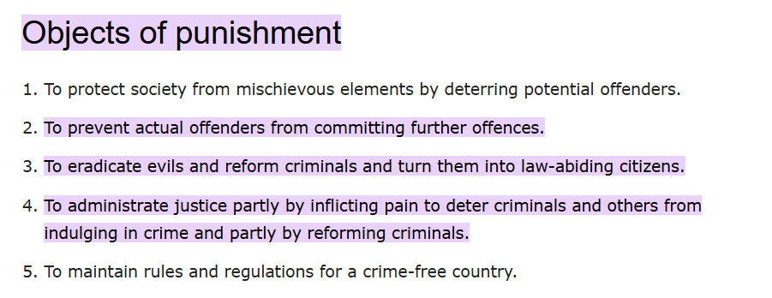
Object of Punishment

Slide 15
Theories associated with the object of Punishment are:
There are five main underlying justifications of criminal punishment considered briefly here: retribution; incapacitation; deterrence; rehabilitation and reparation.
Retribution: To prevent crime by giving victims or society a sense of revenge.
Incapacitation: To prevent crime by removing the defendant from society.
Deterrence: To prevent crime by frightening the public or an individual defendant with punishment.
Rehabilitation: To prevent crime by changing the defendant's behavior.
Reparation: To prevent crime by financially punishing the defendant (by making amends to the victim).

Slide 16
Kind of Punishment
Punishment is the imposition of an undesirable outcome on a group or individual. The practice of the punishment of crimes is known as penology. The authority may be a single person, and punishment will be carried out formally under a law system or informally in other social settings such as within a family. The reason for punishment includes deterrence, rehabilitation, incapacitation, etc.
Punishment can be harmful as well as positive. The depletion of behaviour via the application of an unpleasant stimulus is known as positive punishment, whereas removing a peaceful stimulus is known as negative punishment.
Section 53 of the IPC 1860 mentions five kinds of punishments:
1. Death Penalty
It is capital punishment, as the criminal hangs until death. This type of punishment is rare.
Death punishment can be provided for offences under sections 121, 132, etc.
Case law: Jagmohan Singh Vs. Uttar Pradesh (1973 AIR 947,1973 SCR (2)541).
The death penalty is not constitutional and is proved invalid as a punishment. The Supreme Court recognised the death penalty as valid.
2. Life Imprisonment
The words imprisonment for life were used for transportation for life by Act XXVI of 1955.
In its ordinary connotation, imprisonment for life means being in jail for the whole of the remaining life period of the criminal’s natural life. The supreme court of India defined imprisonment for life as imprisonment for the remainder of the natural energy of the criminal.
As per section 57 of IPC, life imprisonment is 20 years. Imprisonment for life cannot be simple; it is always rigorous.
Case law: Bhagirath Vs. Delhi Admin (1985 AIR 1050)

Slide 17
3) Imprisonment
This punishment removes all the convict’s freedom and puts him in jail. There are two kinds of imprisonment:-
Rigorous
In rigorous imprisonment, the convict works hard as a labourer. They are assigned tasks like cutting wood, digging, etc.
Sec 194, Indian Penal Code: Providing false evidence to procure conviction of the capital offence.
Sec 449, Indian Penal Code: House-trespass with bad intentions are punishable with death.
Simple- Imprisonment where an accused convicted of a crime is kept in prison without any labour or hard work.
4) Forfeiture of Property
Under this punishment, the government seizes all the property or assets of the convicted. The seized property or asset may be movable or immovable. Forfeiture of property as punishment is for offences under section 126 and section 127.
Fine
It is a kind of monetary punishment. The convict has to pay the fine as a punishment for the offence. According to section 64 of the Indian Penal Code, if anyone fails to pay a fine, the court can issue orders for imprisonment.
5) Solitary Confinement
Solitary confinement means keeping the convict isolated and away from any interaction with the world. It comes under Section 73 of the Indian Penal Code.
PLEASE REFER pdf # 10

Slide 18
Primary and Sanctioning Rights
Primary rights are general rights arising from any source whereas sanctioning rights are rights arising from some wrongs.
Primary rights or rights may be explained as the bundle of rights which are the privileges enjoyed by any person, e.g., a person’s right to liberty, safety and reputation. A violation of breach of the primary rights gives rise to a sanctioning right or remedial right. Thus my right not to be libeled is primary, while my right to obtain compensation from one who has libeled me is a sanctioning right. (Libeled meaning - make a false and typically malicious statement about.)
Primary rights, therefore, exist independently, while sanctioning rights have no independent existence and arise only on the violation of primary rights.
The enforcement of a primary right is called specific enforce­ment: the enforcement of a sanctioning right may, according to Salmond, be called sectional enforcement. Proceedings to compel a defendant to pay a debt, to perform a contract or to repay money wrongly received, furnish examples of specific enforcement and the right enforced is primary right.
Sanctioning rights are divisible into two kinds: (1) rights to exact and receive from the defendant a sum of money by way of pecuniary penalty for the wrong which he has committed; and (2) rights to exact and receive damages to compensa­tion for the injury that may have been caused to the sufferer.
Compensation falling under the second form of sanctioning right may either be restitution or penal redress. In the former the defendant is required to restore lo the plaintiff the pecuniary value of some benefit wrongfully obtained by him at the expense of the plaintiff.
In the lacier the defendant is compelled to pay the amount of the plaintiff’s loss which may far exceed the profit received by the defen­dant.
Restitution = Pay back what you unfairly gained.
Penal redress = Fully compensate the victim for their loss, even if it's more than what you profited.

Slide 19
ChatGPT explaination
Restitution: The person who committed the wrongful act (the defendant) must pay back the value of any benefit they unfairly gained from the other party (the plaintiff). This is about returning what was wrongfully taken.
Penal redress: The defendant has to pay the full amount of the loss suffered by the plaintiff. This amount could be much greater than the profit the defendant made. It focuses on fully compensating the injured party, even if it means the defendant pays more than what they gained.

Slide 20
Primary and Secondary functions of Court of Law
primary functions of court:
The functions of the Judiciary are to interpret laws and settle disputes. It is also called the watchdog of democracy. As the guardian of the constitution, it takes care of justice. There are three types of Judiciary in India, namely Supreme Courts, High Courts, and District Courts.
Functions of Judiciary:
It works as the protector of the constitution. Some other functions are listed below:
It takes care of the fundamental rights of the people and protects them
According to the law, it helps in resolving disputes
It helps in carrying out the major political decisions
It ensures that the Constitution is Supreme, and the Judiciary should take all the decisions according to it
It plays a prominent role in law-making
As a watchdog of democracy, it takes care of the proper functioning of the system and government
It is responsible for safeguarding the rights of the people
It also provides advice to the executive and legislative bodies
Whenever there is a dispute between the state and the central, the Judiciary resolves it

Slide 21
Primary and Secondary functions of Court of Law
In addition to their primary function of resolving legal disputes and administering justice, courts have several secondary functions that contribute to the overall functioning of the legal system. Some of these secondary functions include:
Interpretation of Laws: Courts play a crucial role in interpreting laws and determining their constitutionality. They analyze statutes, regulations, and constitutional provisions to provide legal interpretations and establish precedents that guide future legal decisions. (Courts explain what laws mean, check if they match the constitution, and make decisions that guide future legal cases.) ChatGPT short explain
2. Judicial Review: Courts have the power of judicial review, which allows them to review the actions of the executive and legislative branches of government to ensure they are consistent with the Constitution.
3. Law Development: Through their decisions, courts contribute to the development and evolution of laws. By establishing legal precedents and interpreting statutes, courts help shape the legal framework of a jurisdiction and adapt it to changing societal needs.
4. Dispute Resolution: Courts provide a forum for the resolution of disputes between parties. They offer a fair and impartial process for individuals to present their cases, present evidence, and have their disputes resolved in accordance with the law.
5. Deterrence and Rehabilitation: In criminal cases, courts play a role in deterrence by imposing penalties on individuals who have committed offenses. Additionally, courts may also consider rehabilitation as a secondary function by providing opportunities for offenders to reform and reintegrate into society through alternative sentencing options.
6. Public Confidence: Courts help maintain public confidence in the legal system by ensuring transparency, fairness, and the rule of law. Through their decisions and adherence to due process, courts help foster a sense of trust and legitimacy in the justice system.

Slide 22
Law to combat Crime Classification-Civil and Criminal cases
Many laws in India combat crime, including criminal laws, civil laws, and procedural laws:
Criminal laws
The main goal of criminal law is to punish criminals and protect society. Some examples of criminal laws in India include the Indian Penal Code, 1860, the Code of Criminal Procedure, 1973, and the Indian Evidence Act, 1872.
Civil laws
Civil laws deal with non-criminal acts that cause harm to a person or property. Civil laws often involve solving disputes between parties.
Procedural laws
Procedural laws establish the rules of the court and the steps to take when prosecuting or defending a case. Procedural laws are used in both civil and criminal cases.
PLEASE REFER pdf # 6

Slide 23
Law to combat Crime Classification-Civil and Criminal cases
Other types of laws include:
Administrative law: This law governs the structure, responsibilities, and authority of administrative authorities.
Private law: This law regulates relationships between individuals and entities.
Contract law: This law gives the harmed party remedies in addition to the contractual rights and responsibilities of the parties.
Consumer law: This law deals with cases related to consumer rights, such as product defects and unfair trade practices.
Labour law: This law adjudicates matters concerning labor and employment disputes.
Revenue law: This law specializes in land revenue, land disputes, and agricultural tenancy matters.

Slide 24
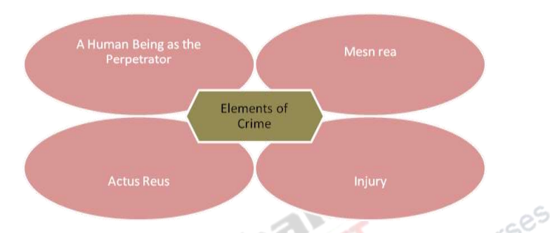
Essential elements of Criminal Law
The Elements of Crime The following four characteristics are the basic elements in all criminal conduct;
Human being as the
Perpetrator
Mens Rea
Actus Reus
Injury

Slide 25
The elements of ‘Mens rea’ and ‘Actus Reus’ have been derived from the Latin maxim of Actus non facit reum nisi mens sit rea which means; ‘An act does not make a man guilty of a crime, unless his mind be also guilty.’ This maxim has formed the foundation of criminal liability in common law jurisdictions and over several centuries has acquired an irrefutable and undisputed solidity.
In essence this maxim mandates that in order to hold person liable for any crime, two elements must be present;
1. The person must have committed an act (Actus Reus)
2. The person must have committed the act with a guilty mind (Mens Rea)
Actus reus refers to the act forbidden by the law for the commission of which a person is held to be criminal liable. It is the other important element which is derived from the maxim of Actus non facit reum nisi mens sit rea.
While the element of mens rea refers to the state of the mind of the accused while committing a physical act, the element of actus reus focuses on the very physical act which forms the subject matter of the crime.
(Below example readonly)
For example, when X takes a movable property from the possession of Y without the consent of Y with a dishonest motive, he is said to commit theft. Here the requisite mens rea consists of the dishonest motive on the part of X. The actus reus consists of the taking away of a movable property from the possession of Y.
In simple terms, actus reus refers to the conduct (act or omission) which is forbidden by the law wherein the person engaging in the forbidden conduct is punishable by a sanction.

Slide 26
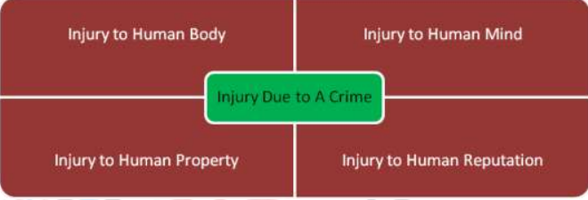
Perpetrator - Human Being A crime can be committed only by a human being. The victims of a crime may be other human being or even animals but the perpetrator who is held liable for having committed a crime cannot be anybody other than a human being.
(Read only - purple)
It may be noted that in ancient and medieval times, even animals were held liable for having committed a crime. There have been several instances of trial being conducted against bull or a pig and then the bull or pig being punished for the crime. However, in modern times, it is a well accepted fact that only a human being can commit a crime. Section 11 of the Indian Penal Code defines a ‘person’ as including a legal person in the form of a company, association or body of persons and excludes animals from the definition.
Injury - in order to constitute a crime, there must be an injury ensuing to other individuals or to the society at large. The nature of the injury may vary depending on the nature of the conduct which is criminalised. Thus, the injury may be in the form of injury to the body, mind reputation or property of another human being. Crimes such as causing of hurt, commission of rape are injurious to the body of another person. Causing of mental harassment and infliction of mental cruelty are crimes against the mind of person. Defamation is a crime against the reputation of a person. Theft, robbery, trespass, misappropriation etc are crimes against the property of another person.
PLEASE REFER pdf # 3 & 6

Slide 27
Constitution and hierarchy of Criminal courts
Different types of Courts :
•Criminal Court Structure under Bharatiya Nagarik Suraksha Sanhita, 2023 (BNSS)
•Civil Procedure Code, 1908 - Civil Court
•Family Law - Family Court
•Special Laws - Special Courts
•Tribunals - Quasi Judicial Authority for Special Subjects
•Lok-Adalat – Alternative Dispute Resolution System is a new mechanism to settled the case outside the court
•Nyay Panchayat Courts
Bharatiya Nagarik Suraksha Sanhita, 2023 - Section 6: Classes of Criminal Courts
Section 6 outlines the different classes of Criminal Courts established in each State, specifying the roles of various types of courts within the legal framework.
Besides the High Courts and the Courts constituted under any law, other than this Sanhita, there shall be, in every State, the following classes of Criminal Courts, namely:
Courts of Session;
Judicial Magistrates of the first class;
Judicial Magistrates of the second class; and
Executive Magistrates.

Slide 28
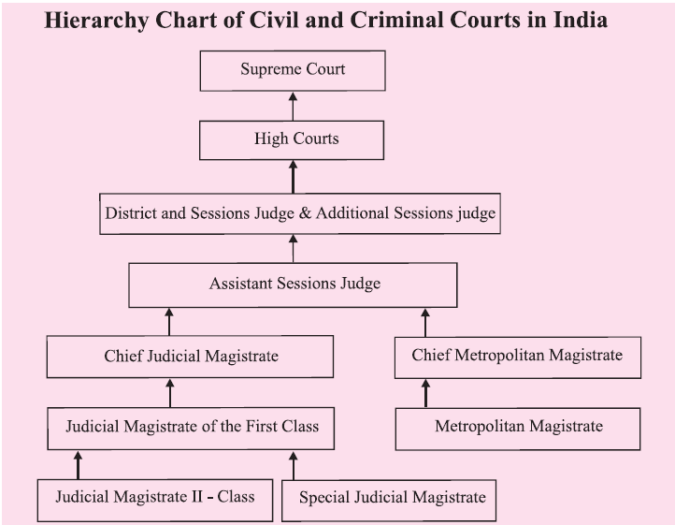
Constitution and hierarchy of Criminal courts

Slide 29
Section 7 outlines the territorial divisions within each State under the Bharatiya Nagarik Suraksha Sanhita, 2023. It establishes that every State is either a sessions division or consists of multiple sessions divisions, which are further categorized into districts. The section also provides authority to the State Government, in consultation with the High Court, to modify these divisions as necessary.
Bharatiya Nagarik Suraksha Sanhita, 2023 - Section 7: Territorial Divisions
Every State shall be a sessions division or shall consist of sessions divisions; and every sessions division shall, for the purposes of this Sanhita, be a district or consist of districts.
(2) The State Government may, after consultation with the High Court, alter the limits or the number of such divisions and districts.
(3) The State Government may, after consultation with the High Court, divide any district into sub-divisions and may alter the limits or the number of such sub-divisions.
(4) The sessions divisions, districts and sub-divisions existing in a State at the commencement of this Sanhita shall be deemed to have been formed under this section.

Slide 30
Explanation with ChatGPT for above topic
Section 7 of the Bharatiya Nagarik Suraksha Sanhita, 2023, talks about how states in India are divided for legal and administrative purposes:
What are sessions divisions?
Every state is divided into areas called "sessions divisions." A state can either be a single session division or have many of them.
Each session division is further divided into smaller parts called "districts."
What does the state government do?
The state government can change these divisions or districts (like merging, splitting, or resizing them) after discussing it with the High Court.
Districts can also be divided into smaller parts called "sub-divisions."
What happens to the current divisions?
The divisions and districts already in place when this law starts will be treated as if they were created under this new law.
So, this section essentially organizes states into manageable areas for administration and justice and allows for changes if needed.

Slide 31
Bailable Vs Non Bailable offences
A bailable offence is a civil/criminal offence for which a court of law grants bail to the accused on a condition to submit a bail bond. However, granting bail doesn't mean that the accused is free. He/she have to go through the judicial trial.
A non-bailable offence is a civil/ criminal offence for which bail can be rejected by the court directly, without hearing the case for certain days. The accused shall be kept under judicial custody until their trial. However, the court may grant bail to the accused depending upon the circumstances and the evidences produced.

Slide 32
Aspect | Bailable Offence | Non-Bailable Offence
Definition | An offense for which bail can be granted at the time of arrest or during the trial process. | An offense for which bail cannot be granted as a matter of right at the time of arrest. The accused must apply to the court for bail.
Bail Granting Authority | Bail can be granted by the police officer or at the police station. | Bail can only be granted by a court of law.
Nature of Crime | Typically, less serious and minor offences. | Generally, more serious and heinous offences.
Severity of Punishment | Lesser penalties and punishments are associated with bailable offenses. | Non-bailable offenses usually carry more severe penalties and punishments.
Police Arrest Without Warrant | Police can arrest without a warrant for bailable offenses. | For non-bailable offenses, police generally require a warrant to make an arrest.
Need for Court Proceedings | For bailable offenses, the accused can be released on bail without going through a court trial. | In non-bailable offenses, the accused must attend court proceedings and apply for bail in front of a judge.
Discretion of the Court | In bailable offenses, the court has the discretion to grant or deny bail based on the circumstances. | In non-bailable offenses, the court must provide strong reasons to grant bail, and it can also deny bail based on the severity of the crime.
Public Perception | Generally perceived as less serious crimes, often involving minor disputes or first-time offenders. | Viewed as more serious crimes, involving acts that can pose a threat to public safety or have significant consequences.
Examples | Simple assault, petty theft, minor traffic violations, etc. | Murder, rape, terrorism, drug trafficking, etc.

Slide 33
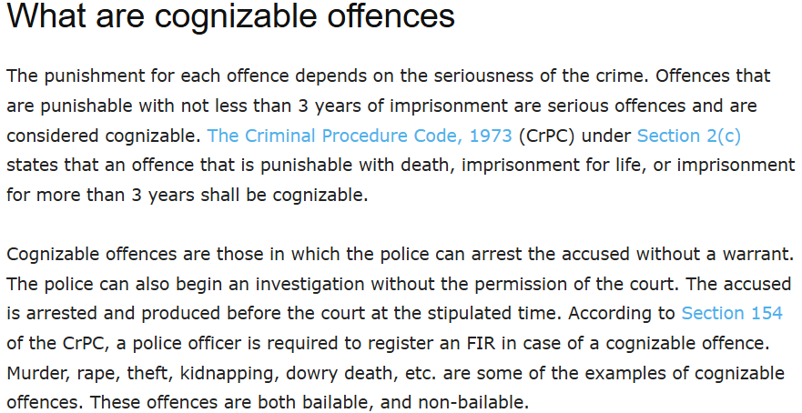
Cognizable Vs Non-Cognizable offences (Just Read it)

Slide 34
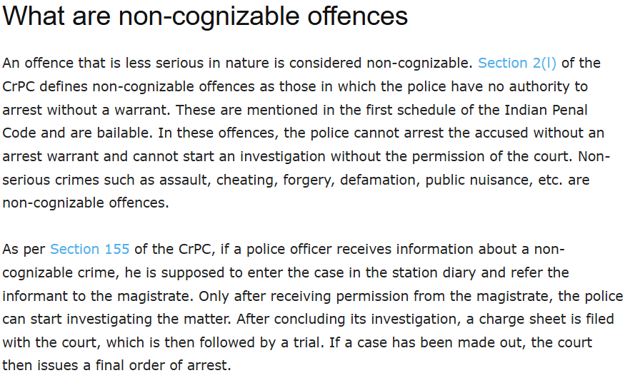
Cognizable Vs Non-Cognizable offences (Just Read it)

Slide 35
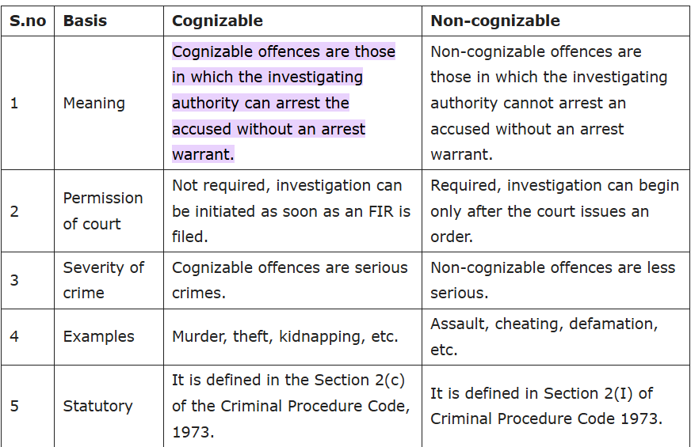
Cognizable Vs Non-Cognizable offences (Imp notes)

